Slide 1
How to build your own neural network
Tutorial PyTorch
Tom van Hogen en Helena Lecluyse

Slide 2
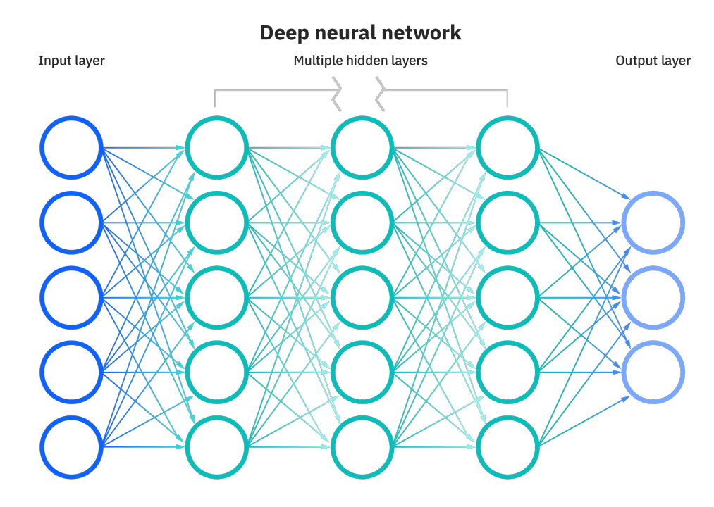
Notes:
basic visualization of a neural network
input layer
output layer
black box containing multiple hidden layers
https://media.licdn.com/dms/image/D4D12AQGBG0RgeyMHVw/article-cover_image-shrink_720_1280/0/1692187763032?e=2147483647&v=beta&t=dGKZmCgg-xWFv_K3y43L2GCAWtszRnP3iBwGsUIjKrg

Slide 3
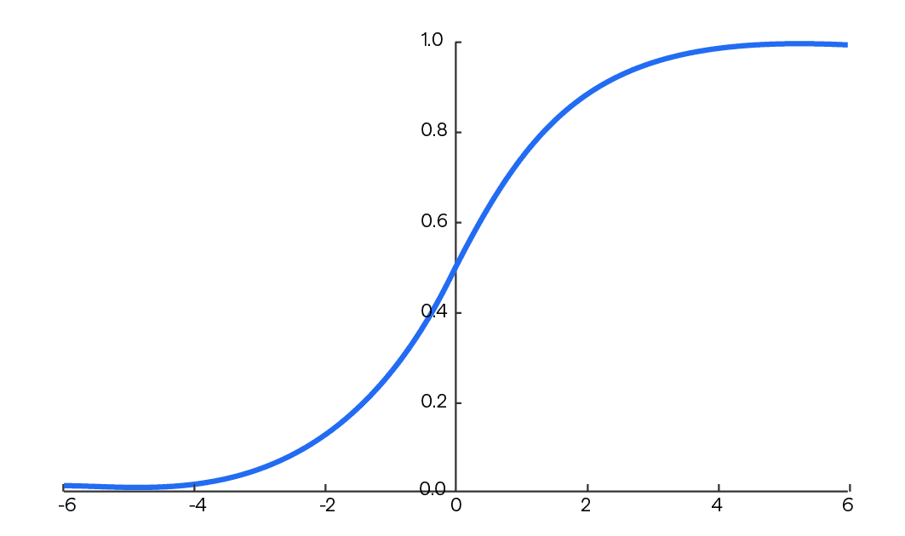
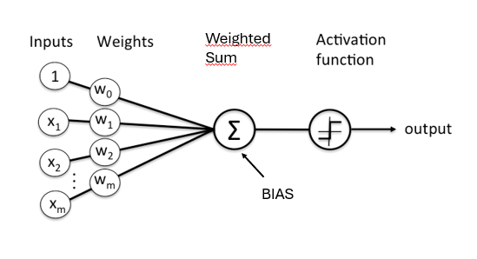
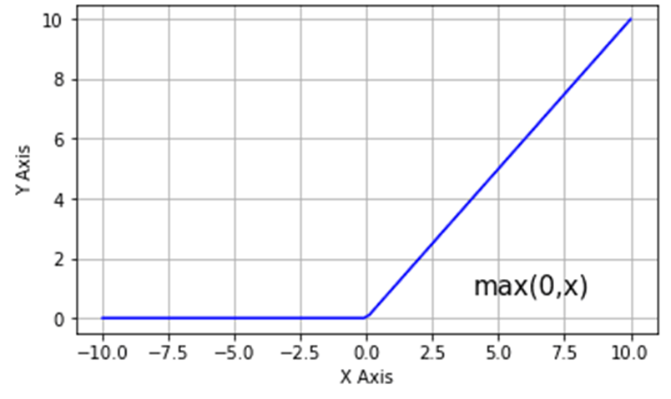
Network components
Softmax
Rectified Linear Unit (ReLU)
Notes:
let’s zoom in on the components that the network is made up of: nodes
it basically comes down to a linear transformation
the activation function can make sure the output of the network is between 0 and 1 resembling probabilities (softmax), but it can also be used to introduce non-linearities (ReLU) in the data to allow the network to learn more complex patterns.
Softmax: https://cdn.botpenguin.com/assets/website/Softmax_Function_07fe934386.png
ReLU: https://www.nomidl.com/deep-learning/what-is-relu-and-sigmoid-activation-function/

Slide 4
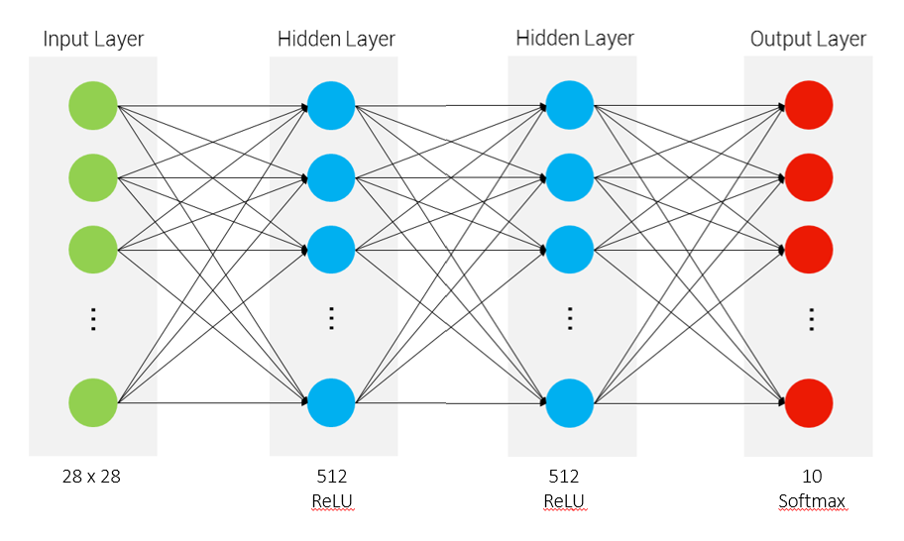
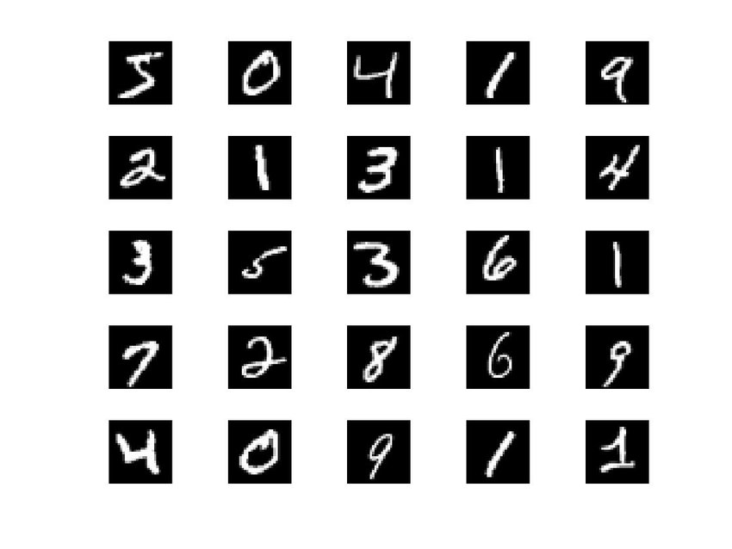
Networks architecture: linear + ReLU
0
1
2
9
Total of 669.706 trainable parameters
Notes:
This is the network we will make in our tutorial
we will use the MNIST dataset

Slide 5
Train the network
batches the number of samples to work through before updating the internal model parameters
epochs one full cycle through the training dataset (containing of # batches)
0
1
2
WRONG
must be 4
9
Notes:
the basic idea is to present the network an image, let the network do its magic and then give feedback
to do this more efficiently we need batches and epochs

Slide 6
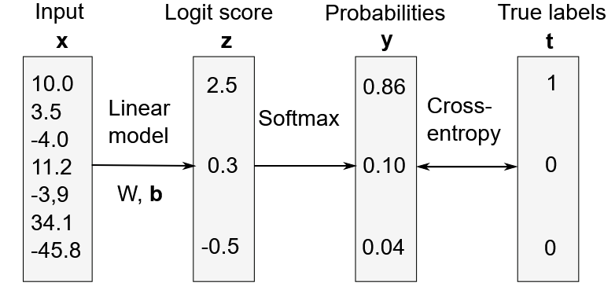
Loss function
How wrong is the model
PyTorch: cross entropy loss
Notes:
but the model needs to know more specifically how wrong it is
in our tutorial we will use cross entropy loss as our loss function
https://julien-vitay.net/lecturenotes-neurocomputing/2-linear/5-Multiclassification.html

Slide 7
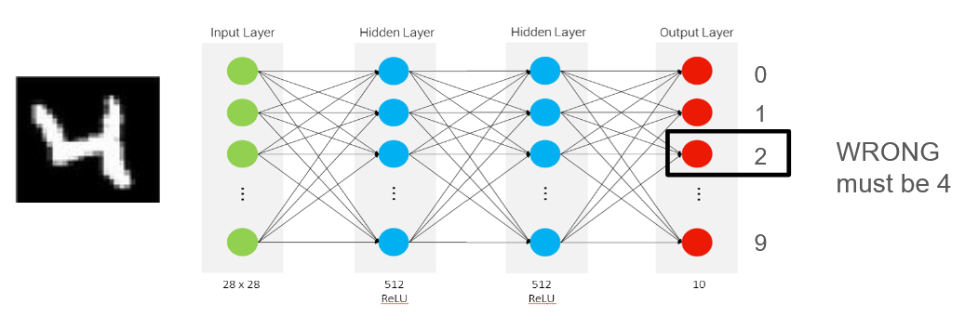
Backpropagation
how can the model improve
update the model's weights and biases
Notes:
process where the model adjusts its internal rules (called weights) based on the loss it calculated, starting with the later layers and going back through the earlier ones
The goal is to reduce the error the next time it makes a prediction.

Slide 8
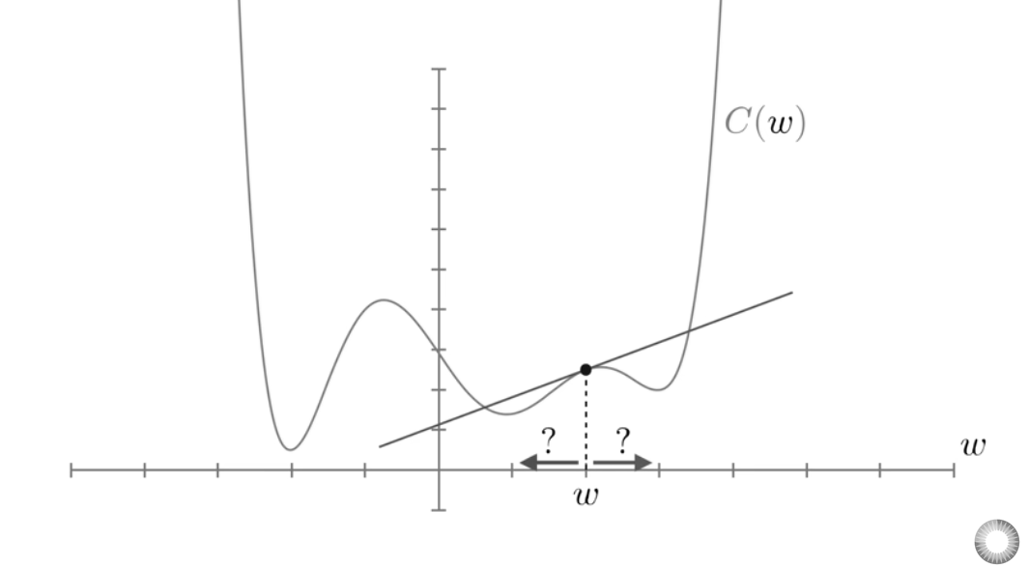
Optimizer
Goal: minimize this loss function
calculate its gradient
learning rate: how much change
Notes:
finding the global minimum directly is to difficult, so you want to calculate the slope to know in which direction you should take a step, such that the loss function will be minimized
https://www.youtube.com/watch?v=IHZwWFHWa-w&t=375s

Slide 9
Optimizer
Goal: minimize this loss function
calculate its gradient
learning rate: how much change
Notes:
in pytorch there are different optimizers, the choice you make also influences how fast the loss function decreases
https://www.youtube.com/watch?v=IHZwWFHWa-w&t=375s

Slide 10



Package Comparison
Keras
High level interface
Easy to learn
Rapid Prototyping
TensorFlow
Keras integration + low-level interface
Steeper learning curve
Scalable
PyTorch
Very ‘Pythonic’ low-level interface
Easier to learn than TF
Easy parallel processing (e.g., use multiple GPU’s)
Popular in academia
Notes:
Source: https://developer.ibm.com/articles/compare-deep-learning-frameworks/#tensorflow0

Slide 11
Let’s get started
open the notebook
if you have any suggestions, concerns, questions after the tutorial, let us know so we can improve it!

